Slide 1
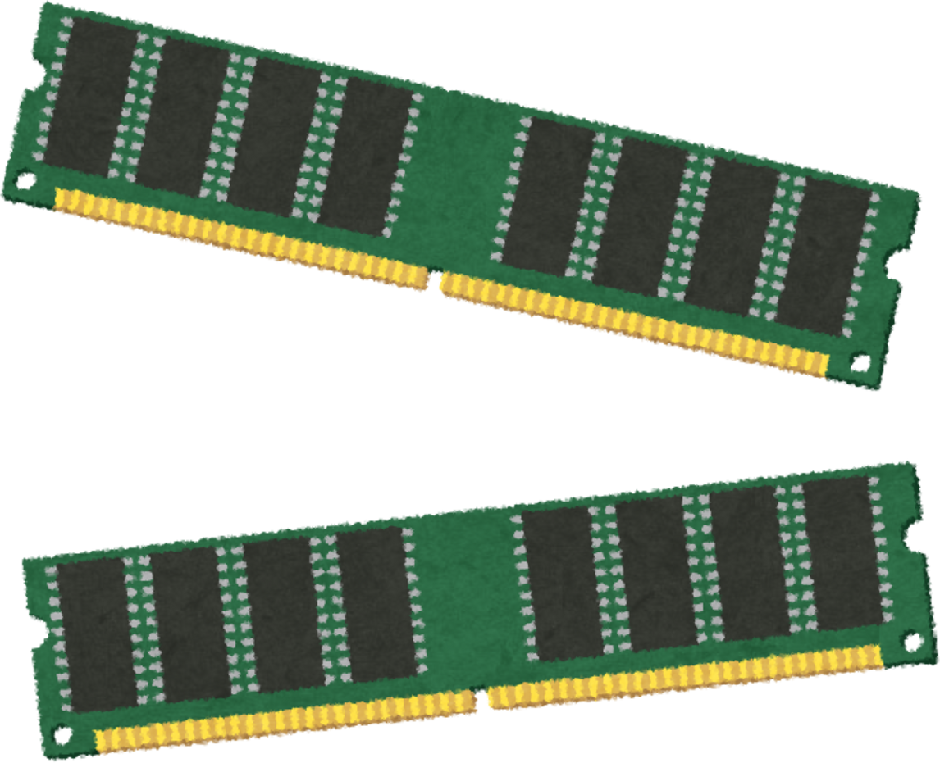
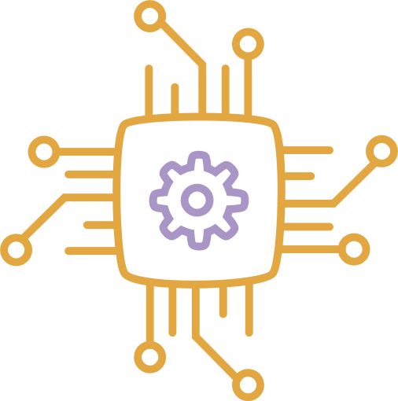
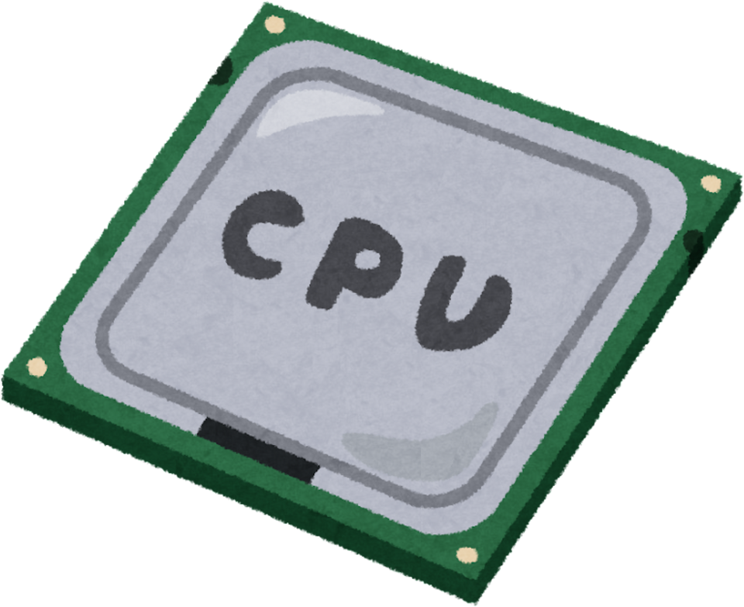
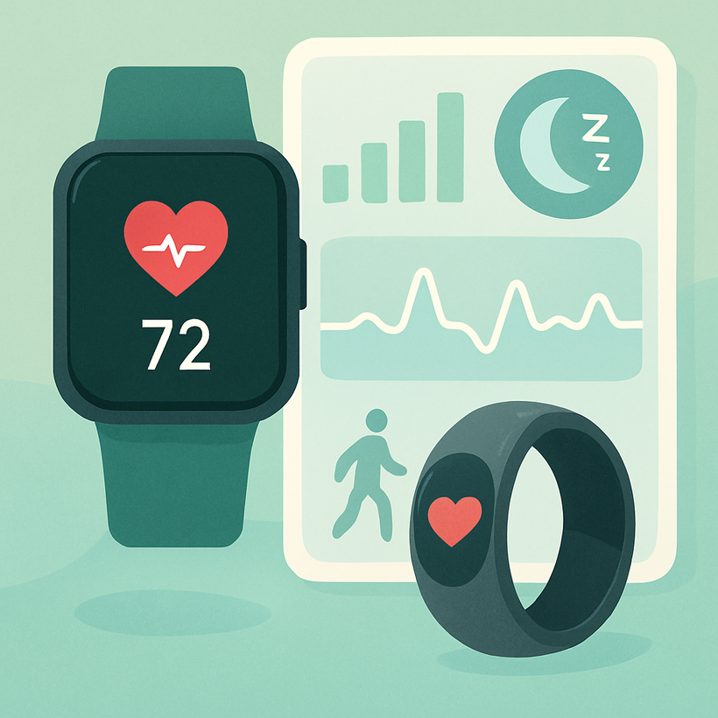
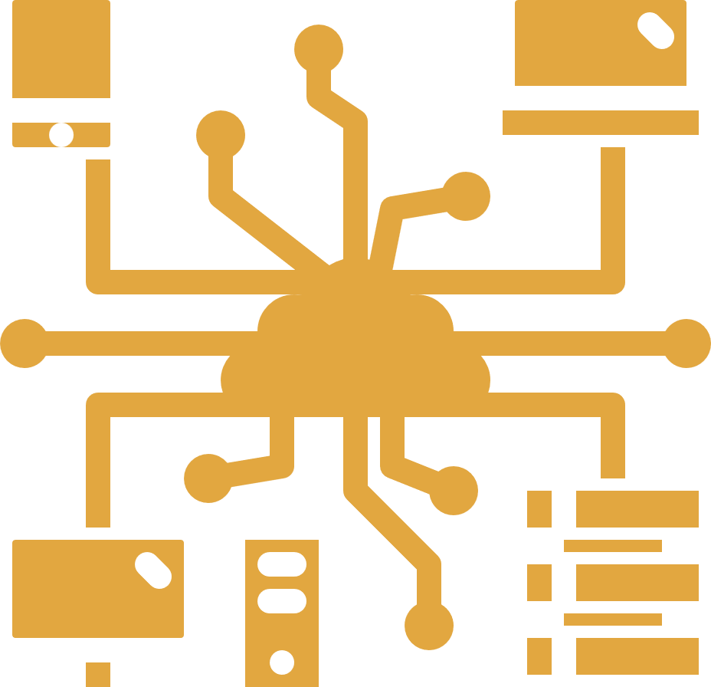
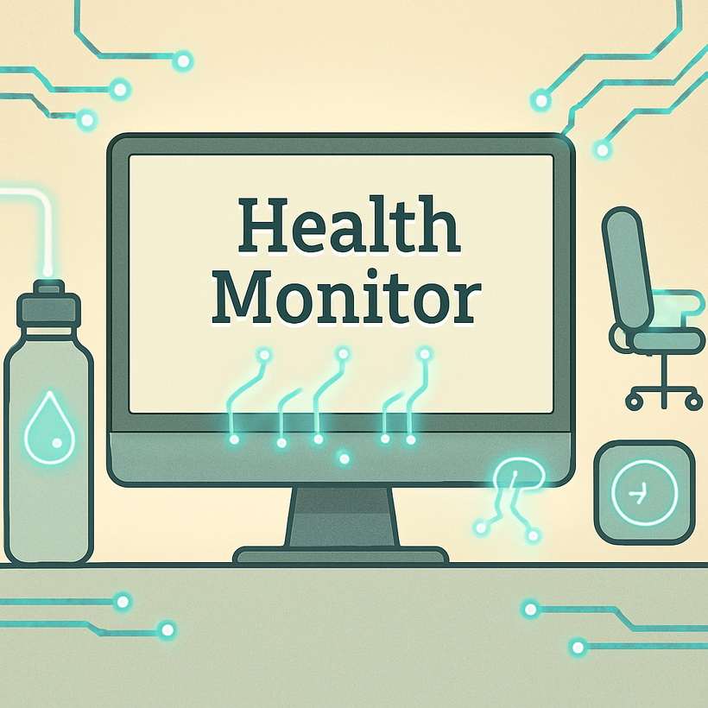
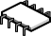
Health Monitor
AI-Powered Posture, Hydration & Screen Time Tracking System
Presented by: Akhil Mittapalli

Slide 2
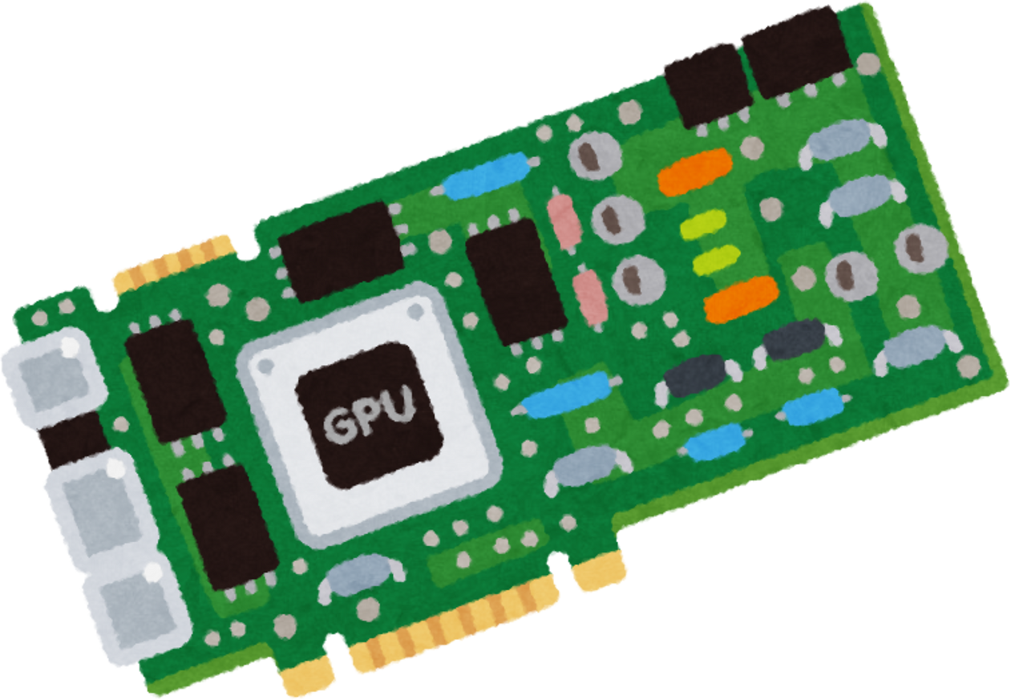
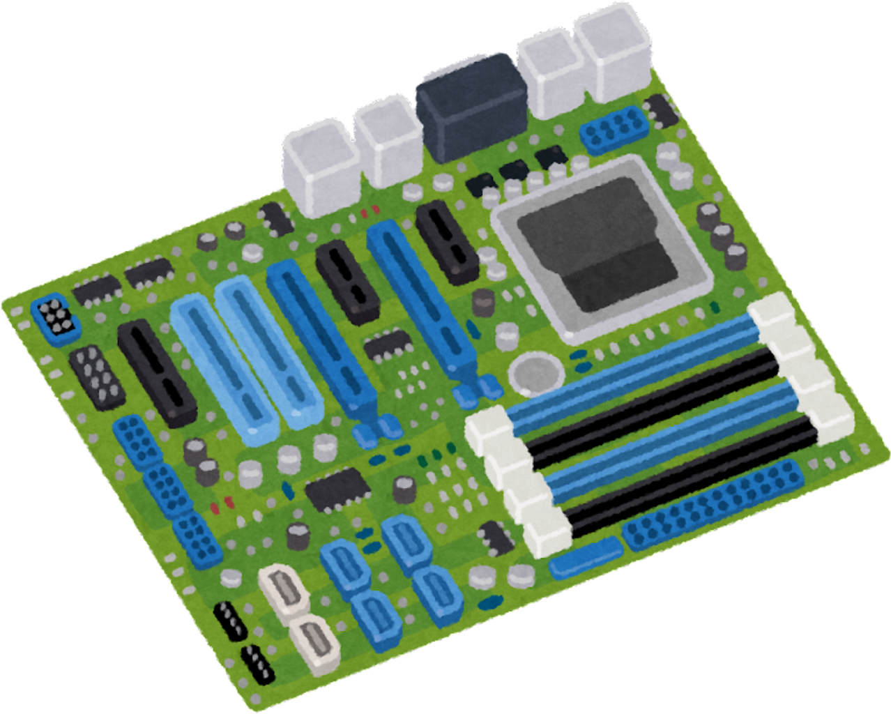
The Problem - Health Challenges in the Digital Age
Statistics:
80% of office workers experience back pain
10+ hours average daily sitting time for desk workers
75% of people are chronically dehydrated
Poor posture leads to long-term health issues
Common Issues:
❌ Forward head posture ("tech neck")
❌ Slouching and poor spinal alignment
❌ Forgetting to drink water
❌ Excessive screen time without breaks
❌ No awareness of unhealthy habits

Slide 3
Our Solution - Health Monitor System
An AI-powered desktop application that:
Features:
✅ Monitors your posture in real-time
✅ Detects when you drink water
✅ Tracks your screen time and breaks
✅ Reminds you to maintain healthy habits
All automatically, using just your webcam!

Slide 4
Key Features Overview
Feature 1: Posture Detection
Real-time analysis of neck/torso angles
Benefit: Prevent pain & injury
Feature 2: Water Tracking
Automatic drinking event detection
Benefit: Stay hydrated
Feature 3: Screen Time
Session monitoring with presence detection
Benefit: Manage work hours
Feature 4: Smart Reminders
Break & hydration alerts
Benefit: Maintain healthy habits

Slide 5
Water Intake Detection Methodology
Approach: Multi-Modal Sensor Fusion
Primary Model: MediaPipe Hands (gesture detection)
Secondary Model: YOLOv8n (object detection)
Method: Combination of gesture recognition + object verification
Two-Stage Detection:
Stage 1: Gesture Detection (Hand-to-Mouth)
MediaPipe tracks 21 hand landmarks
Calculate Euclidean distance between hand and mouth
Threshold: < 0.25 (normalized distance)
Duration: Must be sustained 1 seconds
Stage 2: Object Verification (Bottle in Hand)
YOLO detects water bottles in frame
Calculate bounding box overlap (Intersection over Union)
Verify bottle is actually in hand (>8% overlap)
Confirmation: Both conditions must be true
Event Logic:
Trigger: Gesture + Object + Duration = Drinking Event
Cooldown: 5-second lockout prevents duplicates
Reminder: 30-minute intervals for hydration

Slide 6
Methodology Overview
Phase 1: Research
Analyzed workplace health problems
Studied existing AI detection models
Phase 2: Design
Selected MediaPipe for pose/hand tracking
Integrated YOLO for object detection
Designed modular, extensible architecture
Phase 3: Development
Implemented detection algorithms
Built web-based dashboard with Gradio
Optimized for real-time performance (30 FPS)
Phase 4: Testing
Iterated based on user feedback
Validated accuracy and usability in real conditions

Slide 7
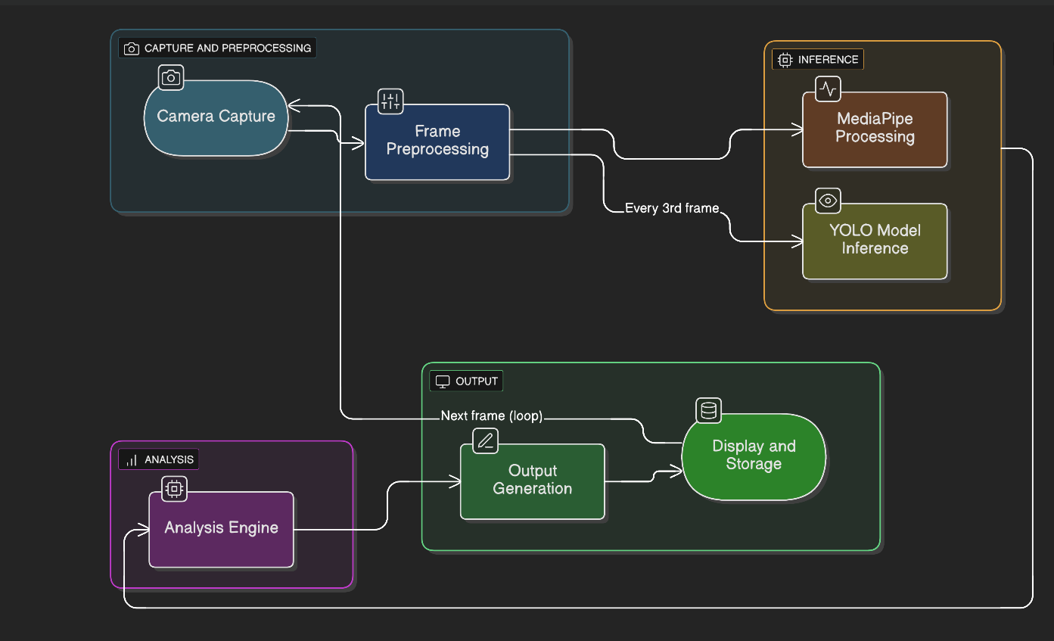
Architecture

Slide 8
Technology Stack
Computer Vision & AI:
OpenCV 4.8+ - Video capture & processing
MediaPipe - Google's pose & hand tracking
YOLOv8n - Real-time object detection
NumPy - Efficient numerical computing
ONNX Runtime - Optimized ML inference
Web Interface:
Gradio 4.0+ - Interactive dashboard
Python 3.8+ - Cross-platform compatibility
Note: CPU-only, no GPU required!

Slide 9
Water Tracking - Deep Dive
Step 1: Hand Gesture
MediaPipe Hands tracks 21 landmarks
Detects hand-to-mouth proximity and head tilt
Sustained for 1 seconds
Step 2: Bottle Detection
YOLOv8n identifies water bottles
Verifies bottle in hand via overlap detection
Reduces false positives by 85%
Step 3: Event Recording
Logs drinking event
5-second cooldown prevents duplicates
Reminds every 30 minutes

Slide 10
Posture Detection - Deep Dive
Thresholds:
✅ Good Posture: Neck < 45°, Torso < 15°
❌ Bad Posture: Exceeds thresholds
⚠️ Alert: Warning after 5 minutes of bad posture
How it Works:
MediaPipe detects 33 body landmarks
Calculates neck angle (shoulder → ear)
Calculates torso angle (hip → shoulder)
Checks shoulder alignment
Visual Feedback:
Colored skeleton overlay (green = good, red = bad)
Real-time angle display

Slide 11
Water Intake Detection Methodology
Approach: Multi-Modal Sensor Fusion
Primary Model: MediaPipe Hands (gesture detection)
Secondary Model: YOLOv8n (object detection)
Method: Combination of gesture recognition + object verification
Two-Stage Detection:
Stage 1: Gesture Detection (Hand-to-Mouth)
MediaPipe tracks 21 hand landmarks
Calculate Euclidean distance between hand and mouth
Threshold: < 0.25 (normalized distance)
Duration: Must be sustained 1 seconds
Stage 2: Object Verification (Bottle in Hand)
YOLO detects water bottles in frame
Calculate bounding box overlap (Intersection over Union)
Verify bottle is actually in hand (>8% overlap)
Confirmation: Both conditions must be true
Event Logic:
Trigger: Gesture + Object + Duration = Drinking Event
Cooldown: 5-second lockout prevents duplicates
Reminder: 30-minute intervals for hydration

Slide 12
Session Tracking Methodology
Approach: Finite State Machine (FSM)
States: ABSENT, PRESENT
Method: Frame counting with hysteresis
Pattern: Event-driven state transitions
State Machine Logic:
Transition Rules:
ABSENT → PRESENT:Condition: Person detected continuously
Duration: 60 frames (2 seconds)
Action: Start new session, reset counters
PRESENT → ABSENT:Condition: No person detected
Duration: 15 seconds (450 frames)
Action: End session, save statistics
Why Hysteresis (Different Entry/Exit Times):
2 seconds to start: Prevents false starts from brief appearances
15 seconds to end: Prevents false ends from brief movements
Asymmetric timing provides stability
Tracked Metrics:
Timestamps (start, end)
Posture time (good vs bad)
Water intake events
Reminder counts

Slide 13
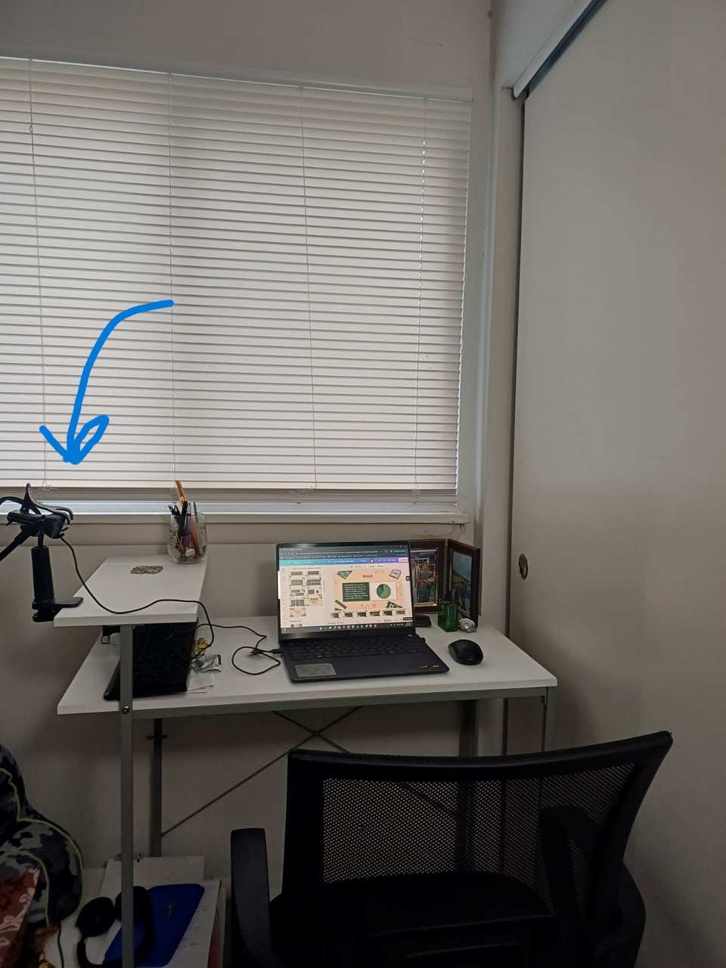
Set up

Slide 14
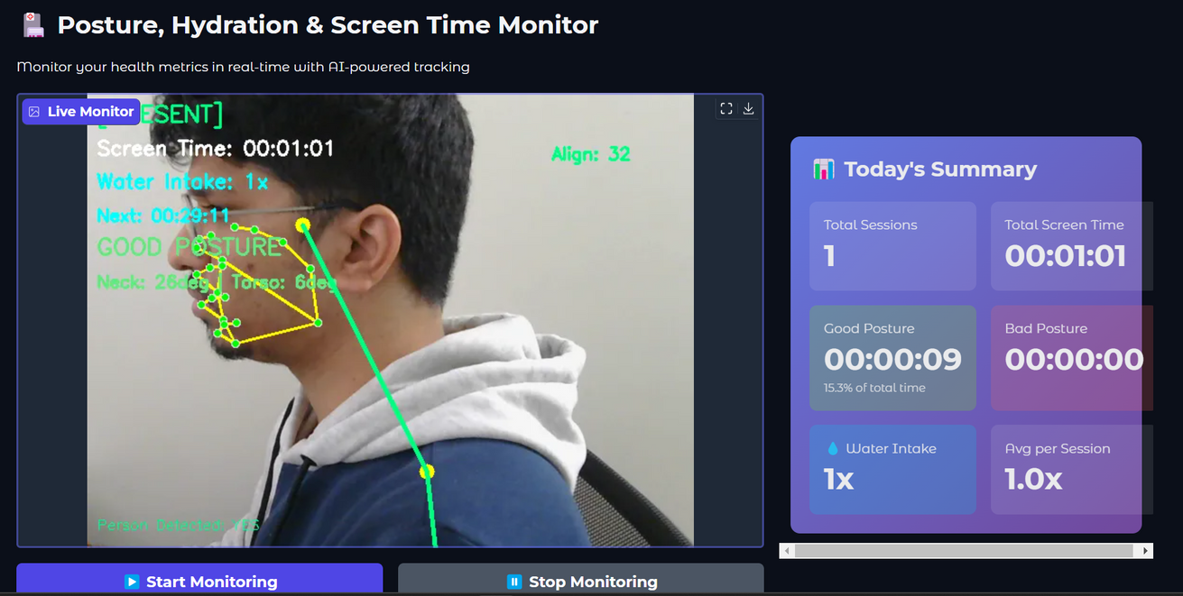
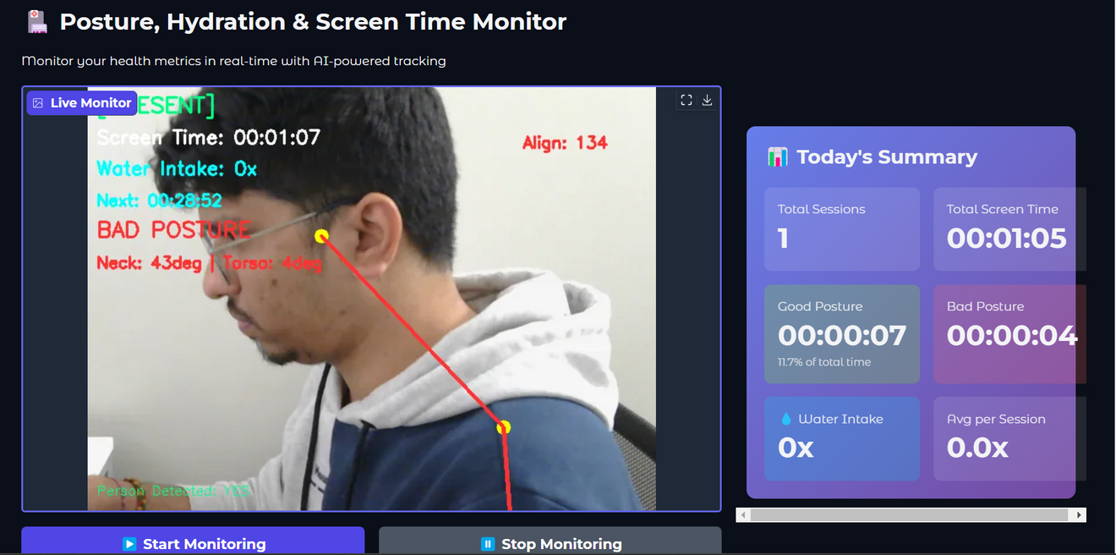
Results

Slide 15
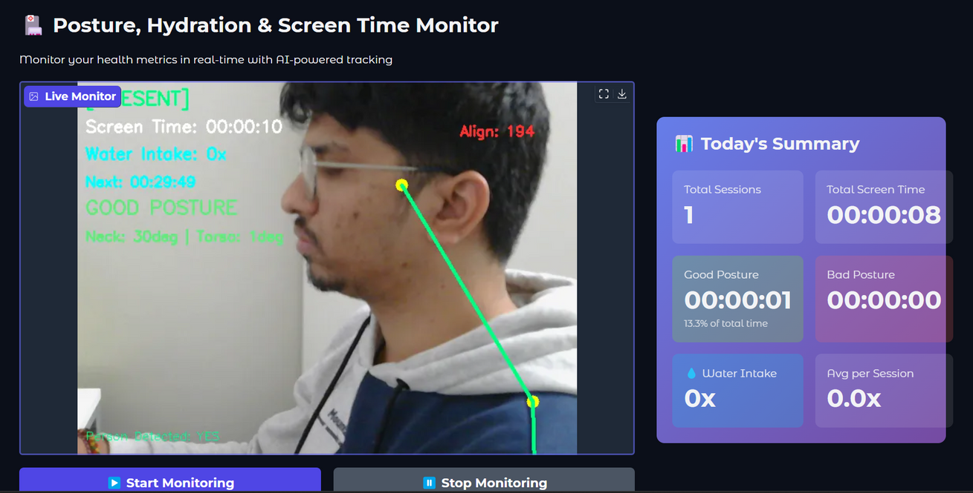
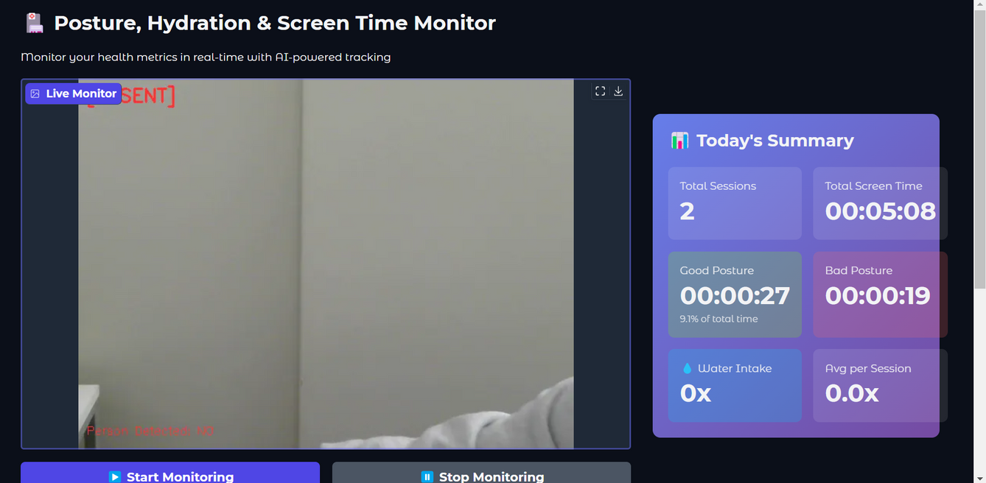
Result

Slide 16
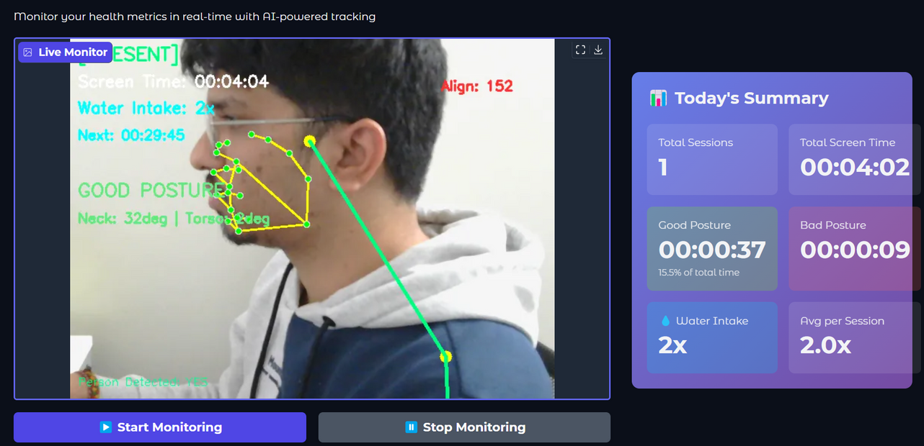
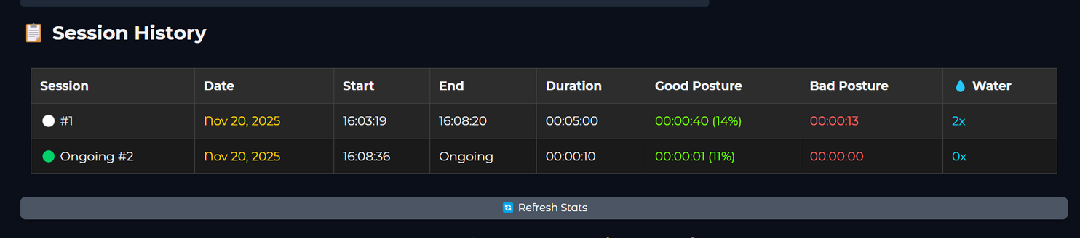

Slide 17
Future Scope
Enhanced Analytics
Weekly/monthly trends
Progress charts
Smart Notifications
Custom reminder schedules
Do Not Disturb mode
Eye Care Features
Blink rate monitoring
20-20-20 rule reminders
Screen distance alerts

Slide 18
Call to Action
For Individual Users:
Download from GitHub repository
Install dependencies in 5 minutes
Start monitoring and improving your health
Track progress over time
For Developers:
Clone the open-source repository
Explore the modular codebase
Contribute improvements and new features
Join the community
For Organizations:
Pilot with small teams (5-10 people)
Measure health improvements and productivity
Scale across entire organization
Customize for your workplace needs
Making healthy computer use effortless and automatic

Slide 19
Welcome to
Discussion Time

Slide 20
Thank You

